Slide 1

PCWG-Share-01 Initial Results
PCWG Meeting Kings Langley
9th December 2015
Peter Stuart (RES), Lee Cameron (RES), Alex Clerc (RES)
& Andy Clifton (NREL), on behalf of the Power Curve Working Group

Slide 2

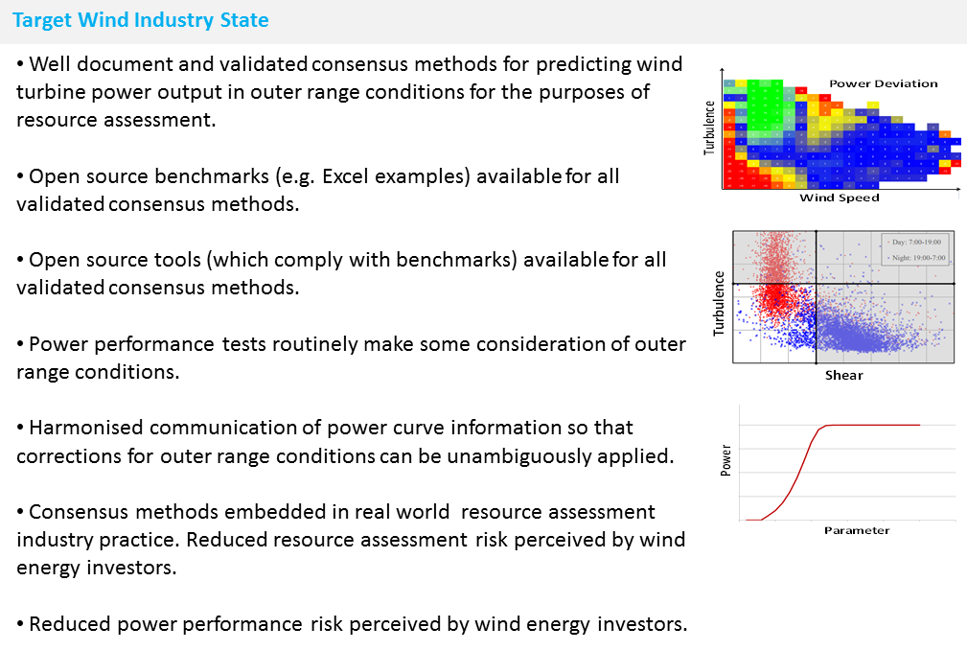
Download PCWG 2015 ‘A3’ Roadmap from www.pcwg.org

Slide 3
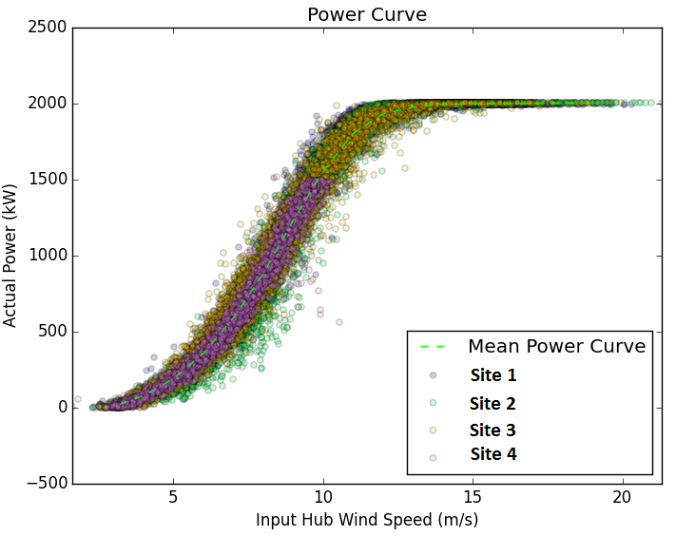
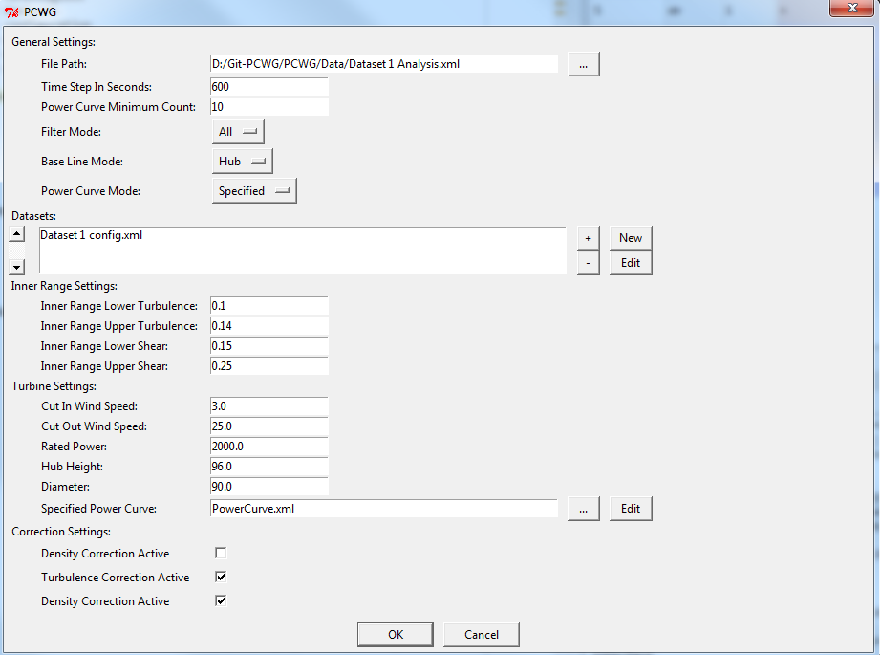
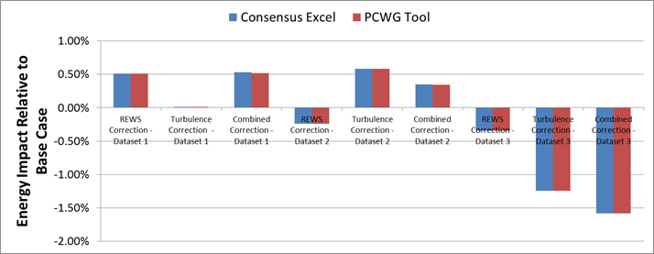
PCWG-Share-01: PCWG Analysis Tool
PCWG-Share-01: Enabled by PCWG Analysis Tool.
Consistent data analysis and anonymous report generation.
‘Just do it’ PCWG-Share-01 button (minimise set-up time)
Excel Benchmark and PCWG Analysis Tool Comparison

Slide 4
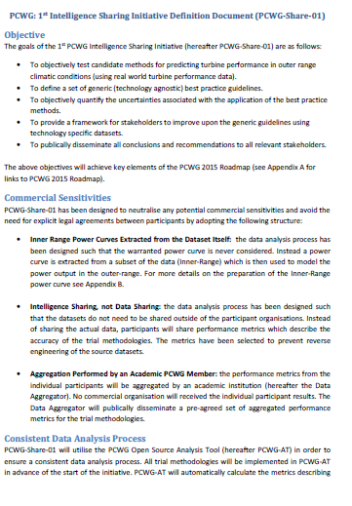
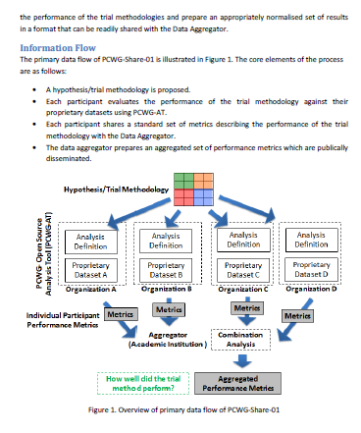
PCWG-Share-01 Definition Document
Download PCWG-Share-01 Definition Doc from www.pcwg.prg

Slide 5
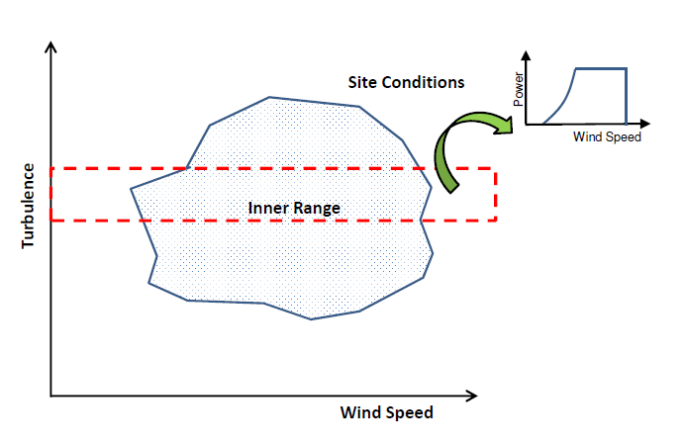
PCWG-Share-01: Neutralising Commercial Sensitivities
Inner Range Power Curves Extracted from the Dataset Itself: the data analysis process has been designed such that the warranted power curve is never considered. Instead a power curve is extracted from a subset of the data (Inner-Range) which is then used to model the power output in the outer-range.
Intelligence Sharing, not Data Sharing: the data analysis process has been designed such that the datasets do not need to be shared outside of the participant organisations. Instead of sharing the actual data, participants will share performance metrics which describe the accuracy of the trial methodologies.

Slide 6
PCWG-Share-01: Data Flow
Hypothesis/Trial Methodology
Analysis Definition Y
Analysis Definition Y
Analysis Definition Y
Analysis Definition Y
Proprietary Dataset A
Proprietary Dataset B
Proprietary Dataset C
Proprietary Dataset D
Organization A
Organization B
Organization C
Organization D
Hypothesis Performance Metrics
Aggregator
(Academic Institution )
Combination Analysis
How well did the trial method perform?
Aggregated Hypothesis Performance Metrics

Slide 7
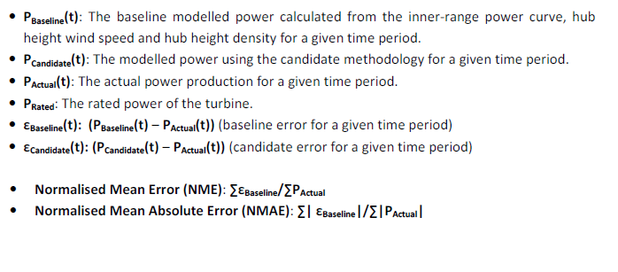
PCWG-Share-01: Error Metric Definitions
See PCWG-Share-01 Definition Document for Further Details

Slide 8
PCWG-Share-01: Timeline
Finalise Definition Doc
Finalise Analysis Tool
PCWG Participants work to set up their proprietary datasets
Aggregate Initial results + Present
Deadline for final results submission was 23rd November 2015.
Results were be combined by Data Aggregator (NREL) for presentation at the December 2015 PCWG meeting.
PCWG Participants perform further analysis
Aggregate final results + Present
Agree Conclusions
Time
June
July
Aug
Sep
Oct
Nov
Dec
Roskilde
PCWG Meeting
US PCWG Meeting
Aarhus
PCWG Meeting
EWEA Paris
London
PCWG Meeting
AWEA New Orleans

Slide 9
PCWG-Share-01: PCWG Analysis Tool
Version | Comment | Submissions
0.5.8 (Beta 2) | Pre-release version used in a few of the RES submissions (identical to 0.5.8) | 52
0.5.8 | Version used in original round of submissions
0.5.9 | Changes to interpolation method (more later). No contribution to errors from unpopulated bins. | 47 (resubmissions)
0.5.10 | Slightly relaxed submission criteria (fewer populated bins required).

Slide 10
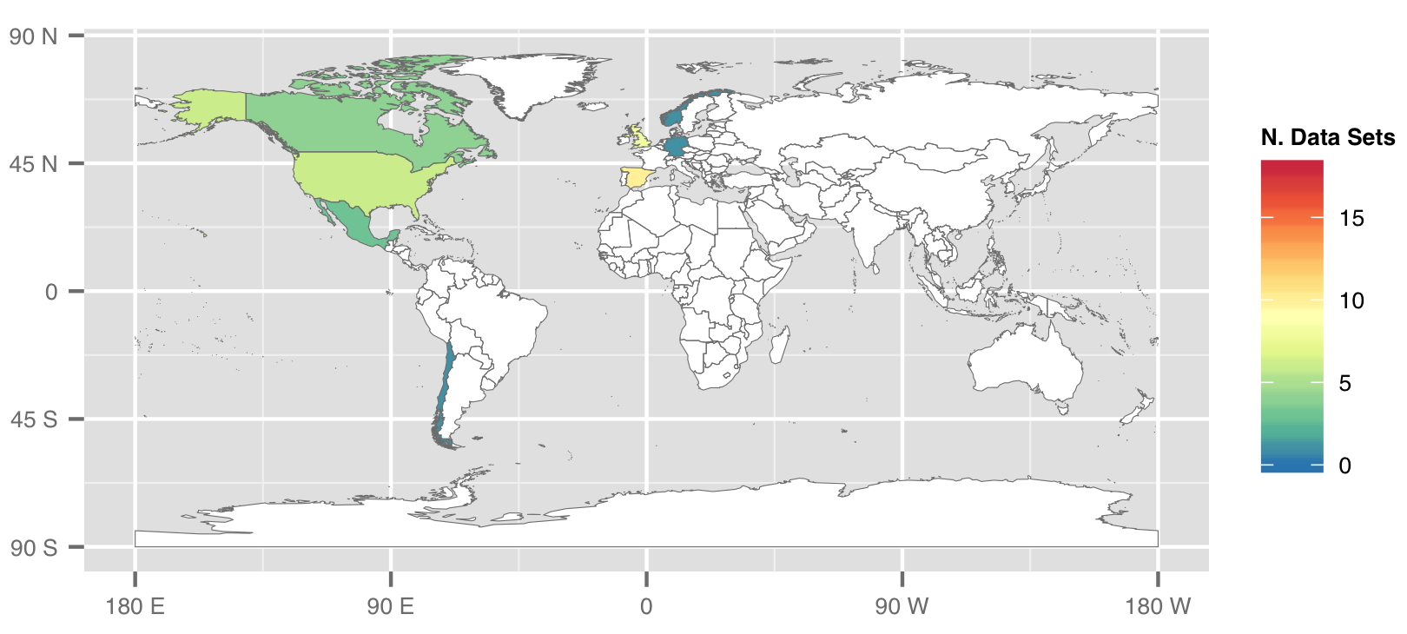
PCWG-Share-01: Submission Map

Slide 11
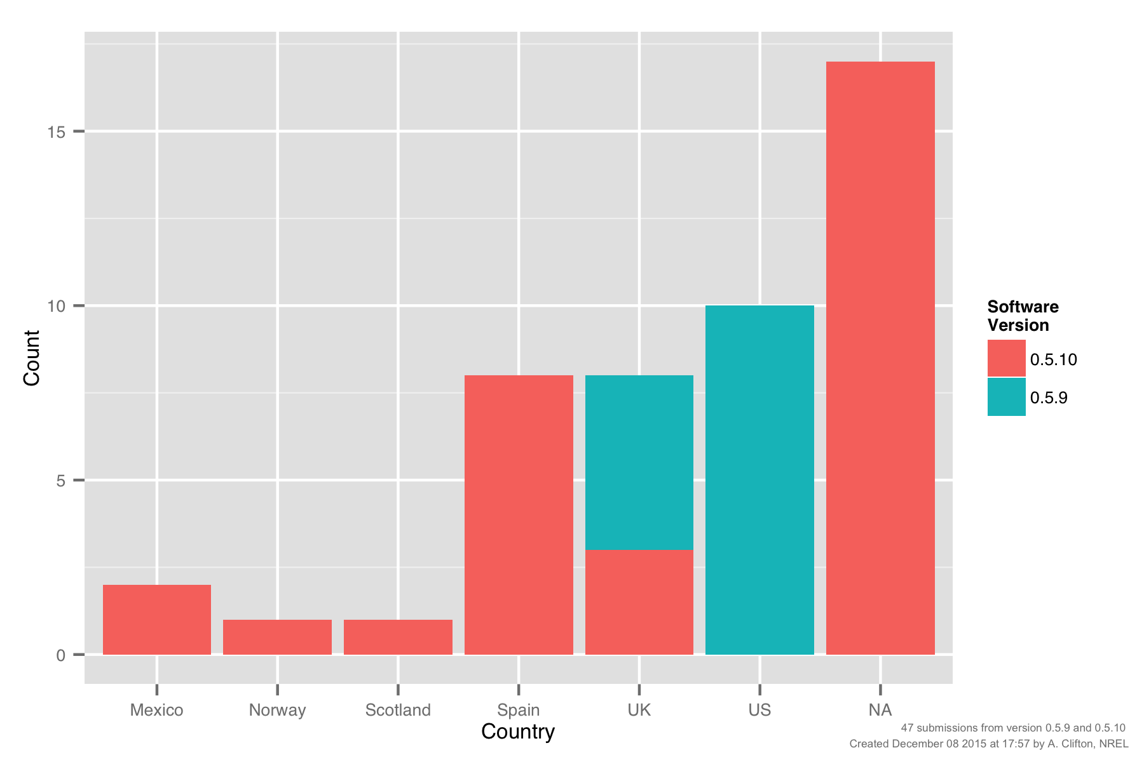
PCWG-Share-01: Submissions by Country

Slide 12
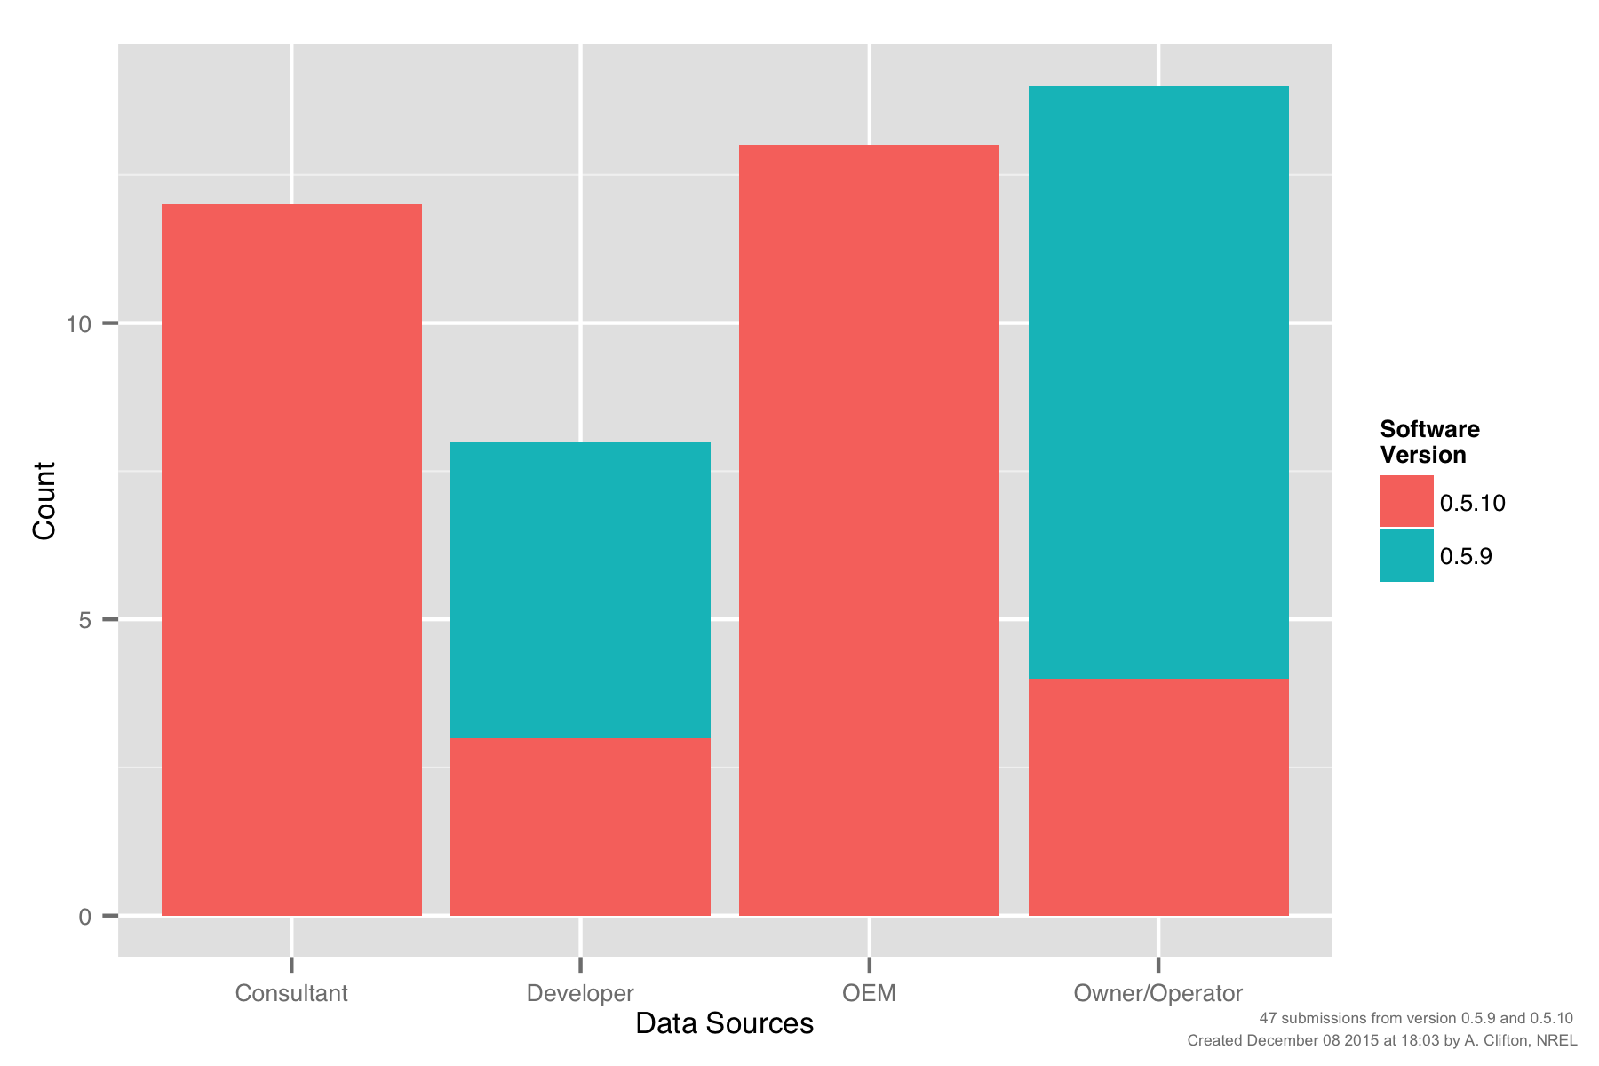
PCWG-Share-01: Submissions by Participant Type

Slide 13
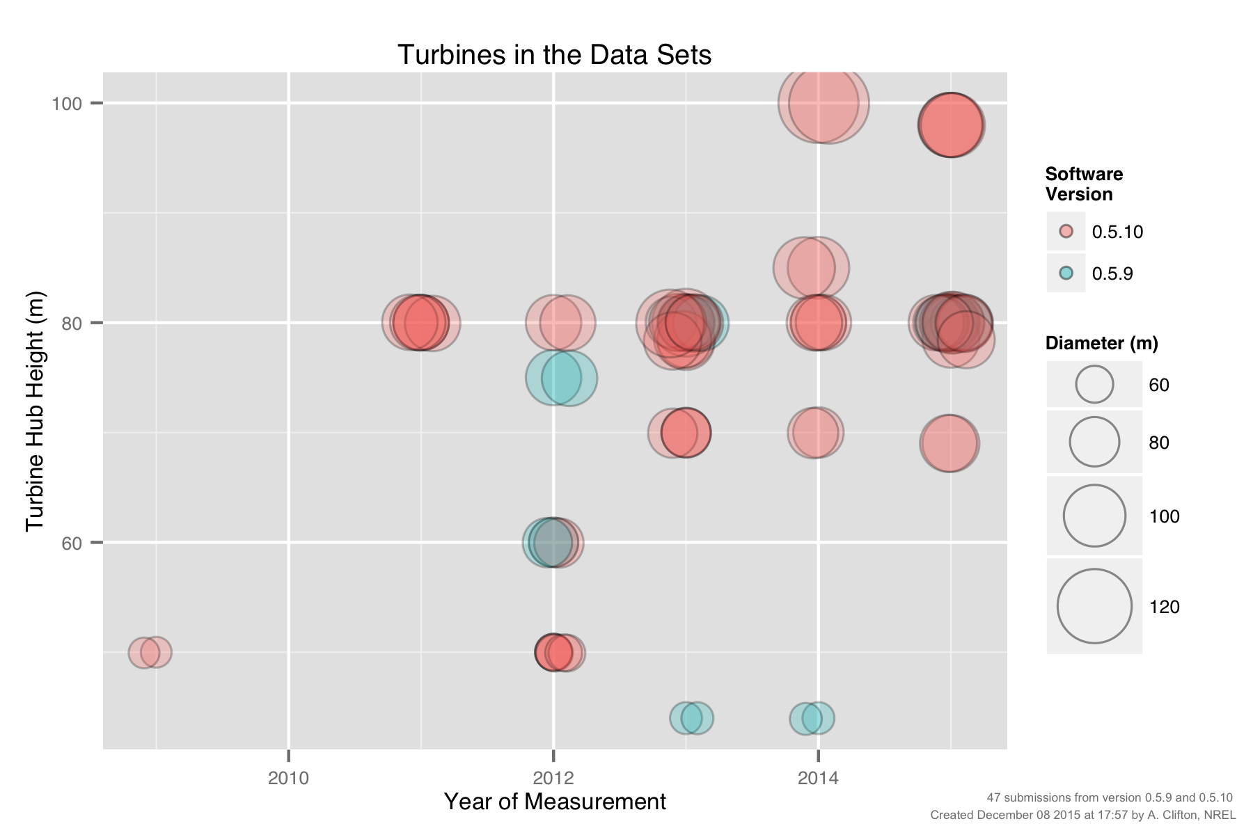
PCWG-Share-01: Turbine Size vs Measurement Year

Slide 14
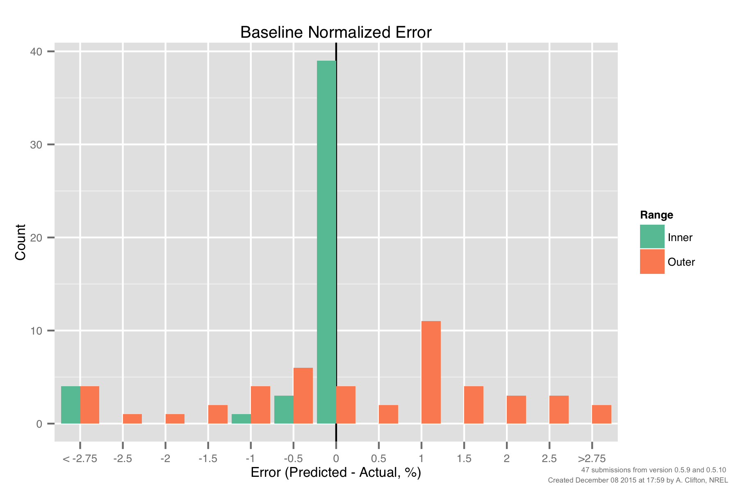
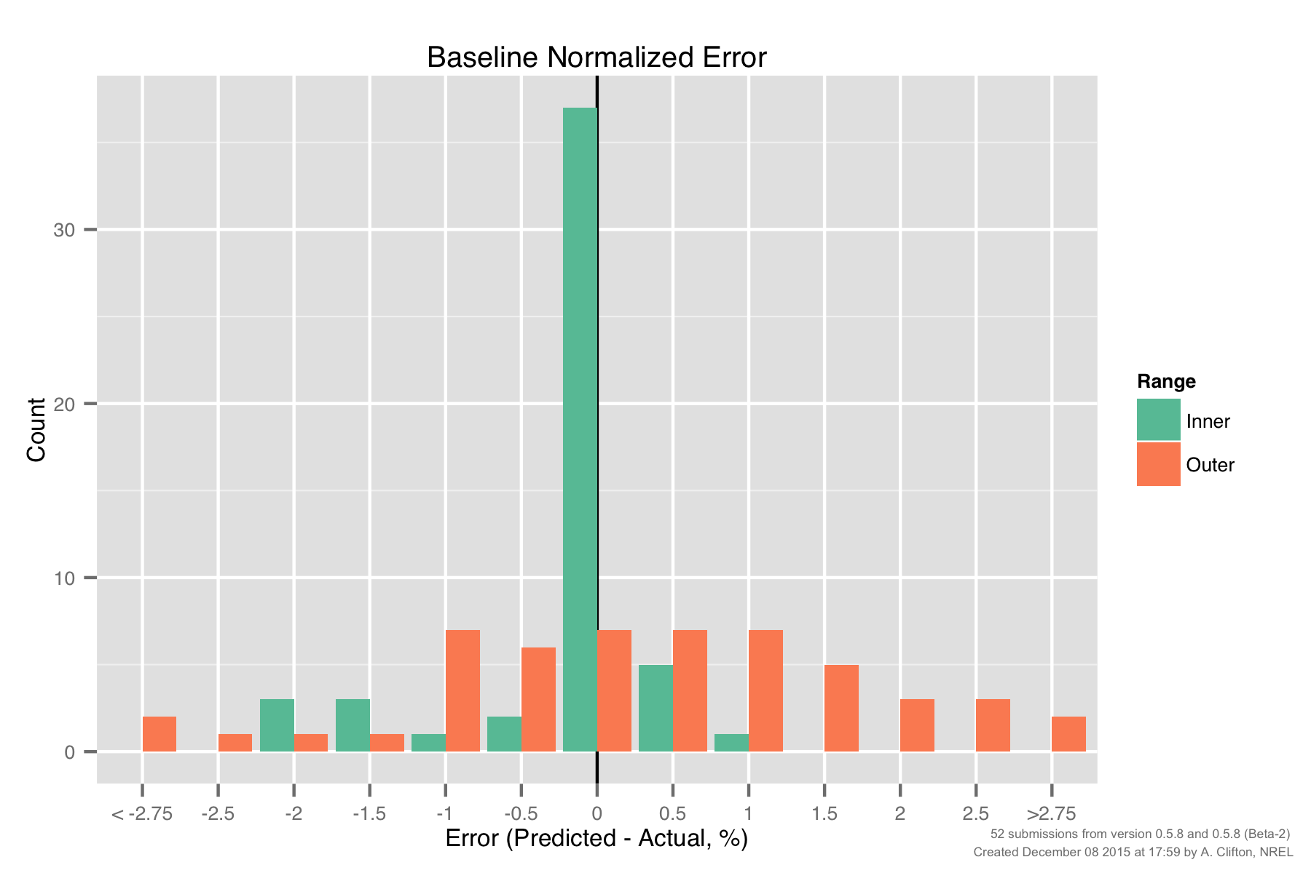
PCWG-Share-01: Baseline Error, Inner vs Outer Range
Version 0.5.9/10
Still unexpectedly large errors for baseline inner range
(further investigation required)
Smaller inner baseline errors still warrant further investigation
‘Uncertainty’ associated with
‘Outer Range’ effects.
Std Dev ≈ 2%

Slide 15
POWER CURVE
INTERPOLATION ISSUE

Slide 16
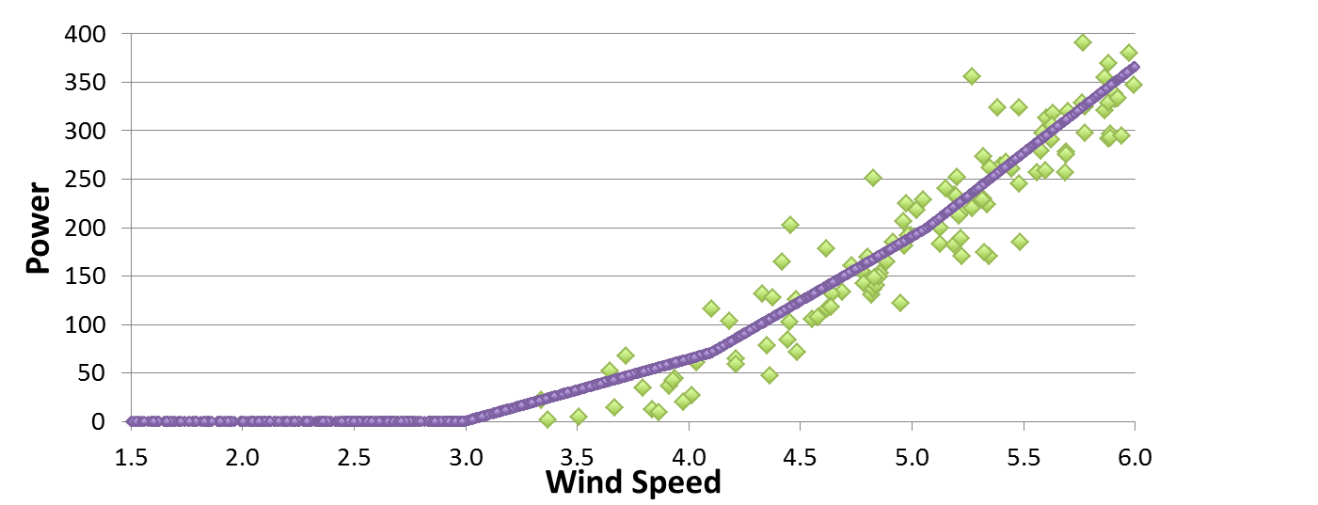
Inner Range Baseline Error
What is inner range baseline error?
The Inner Range power curve is derived from the Inner Range data
Each Inner Range data point is compared to the Inner Range power curve. The error for each data point is calculated.
The error is summarised as NME (Normalised Mean Error). This is expected to be 0 for the inner range!
HOWEVER The inner range baseline error may not be 0 depending on interpolation of the power curve!
Error for each point is the difference from the interpolated power curve

Slide 17
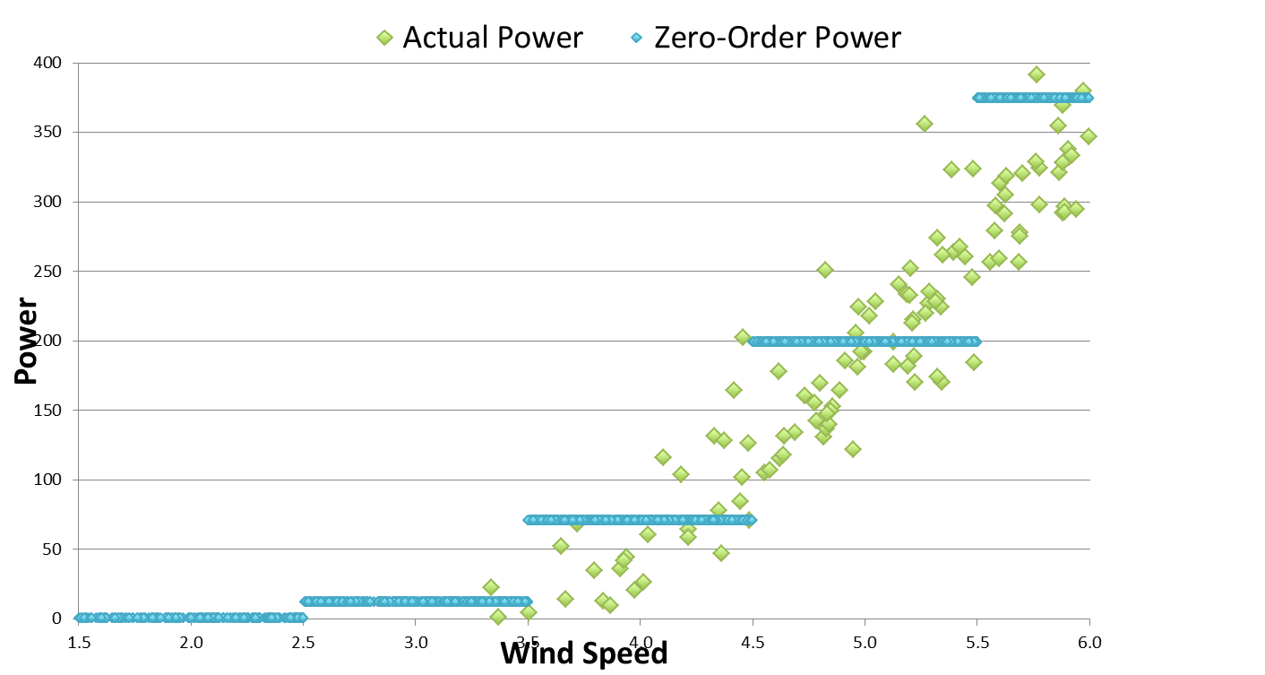
Zero-Order interpolation: easy to get 0 NME (just use the bin average power) but large errors for individual data points.

Slide 18
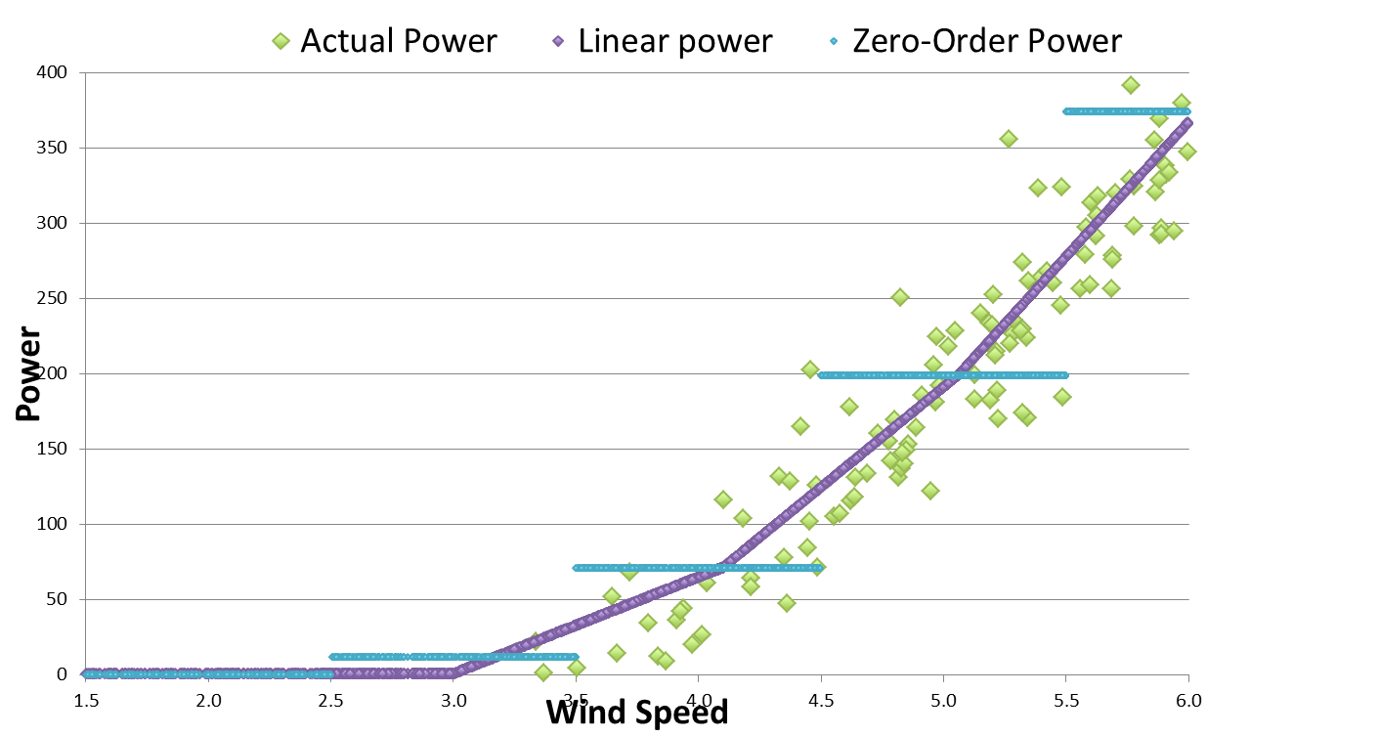
Linear Interpolation: v0.5.8 and earlier, improvement for individual data points but noticeable over prediction at low wind speed

Slide 19
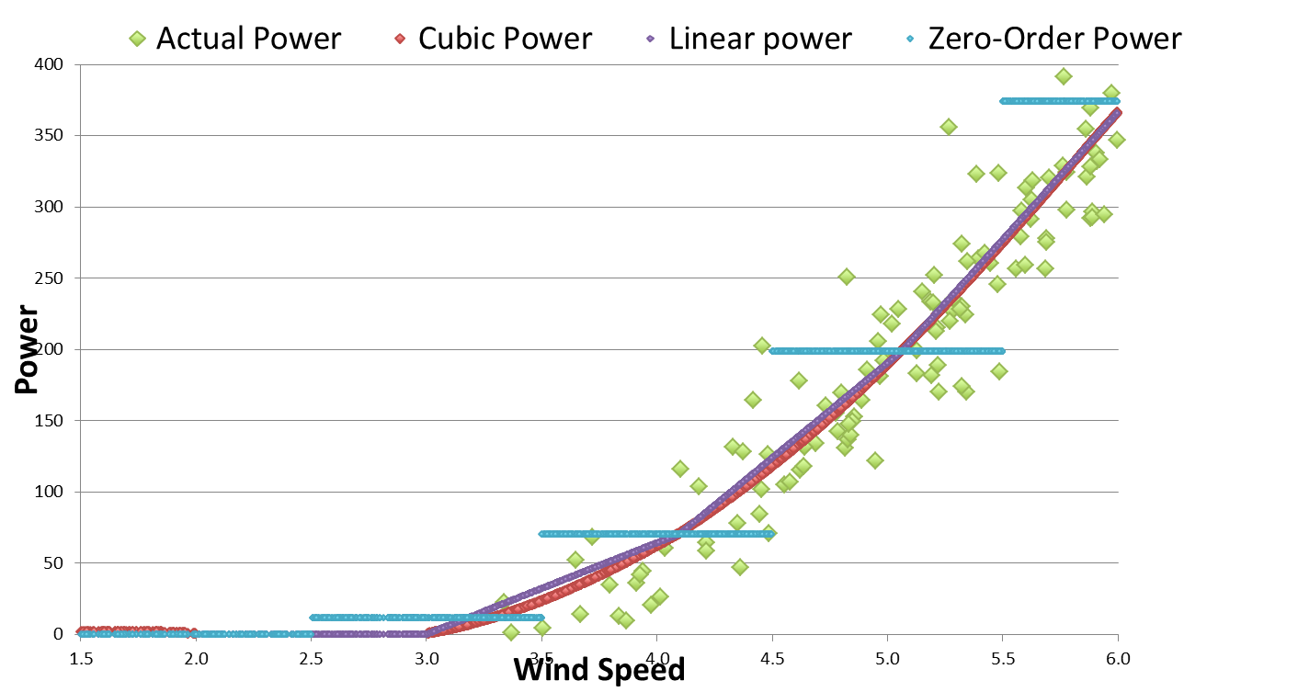
Cubic interpolation: introduced in v0.5.9 for PCWG-Share-01. Noticeably reduces error at low wind speed compared to linear.

Slide 20
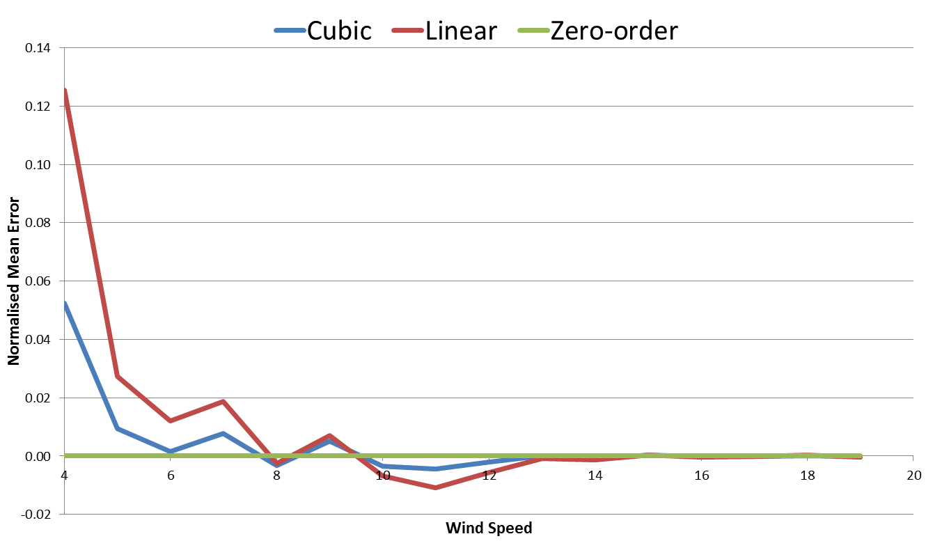
Normalised Mean Error (NME) by wind speed:
Cubic interpolation has similar but smaller errors than linear.
Zero-order has 0 error by definition
Cubic and linear interpolators over estimate data at the ankle
Cubic and linear interpolators under estimate data at the knee

Slide 21
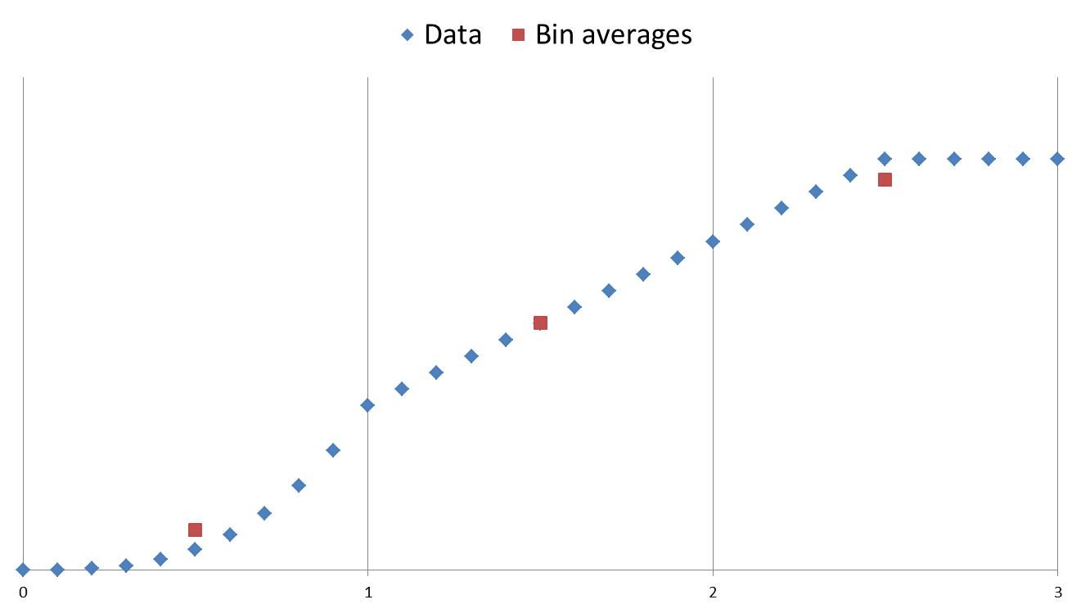
Residual Error
Main reason for residual error: Bin averages are used as interpolation points. Unfortunately the bin averages do not lie exactly on the curve when the underlying function is non-linear.
Cubic
(Convex)
Clipped
(Concave)
Linear
The bin average, (avg(x), avg(y)),
is below the curve
The bin average, (avg(x), avg(y)),
is above the curve
The bin average, (avg(x), avg(y)),
is on the curve

Slide 22
Possible solutions
The problem is that bin average power does not well represent bin centre power
The bin averaging process is very similar to the effect of turbulence. An iterative correction method similar to the Albers method could be applied to find the true bin centres.
In the rising part of the curve, evaluate bin average Cp, consider this to be bin centre Cp, and convert to bin centre power. Cp data is a bit less non-linear than power.

Slide 23
PCWG-Share-01 RESULTS

Slide 24
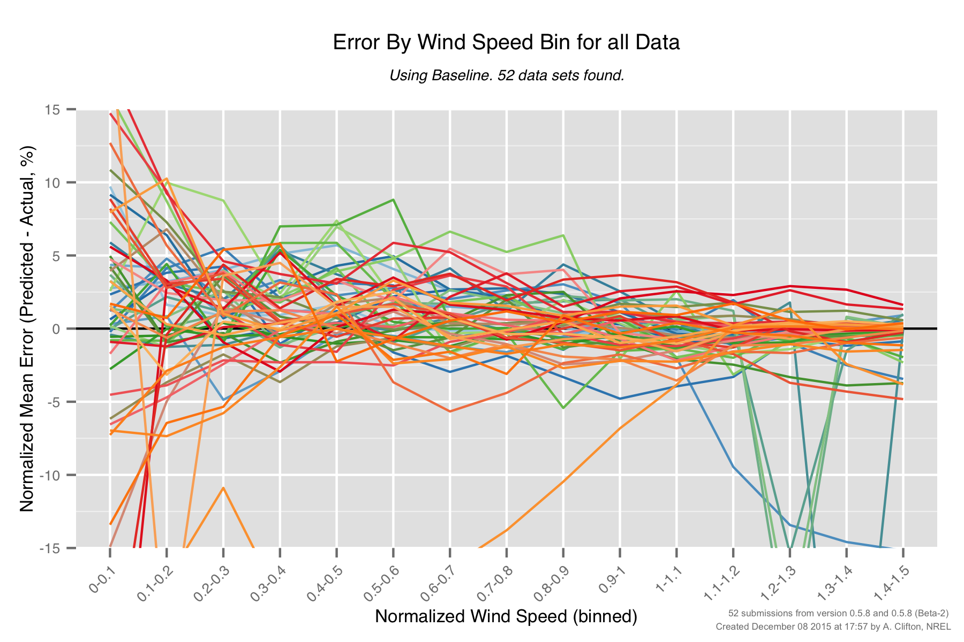
PCWG-Share-01: Baseline Errors by Wind Speed (0.5.8)
Large errors above rated for certain datasets.

Slide 25
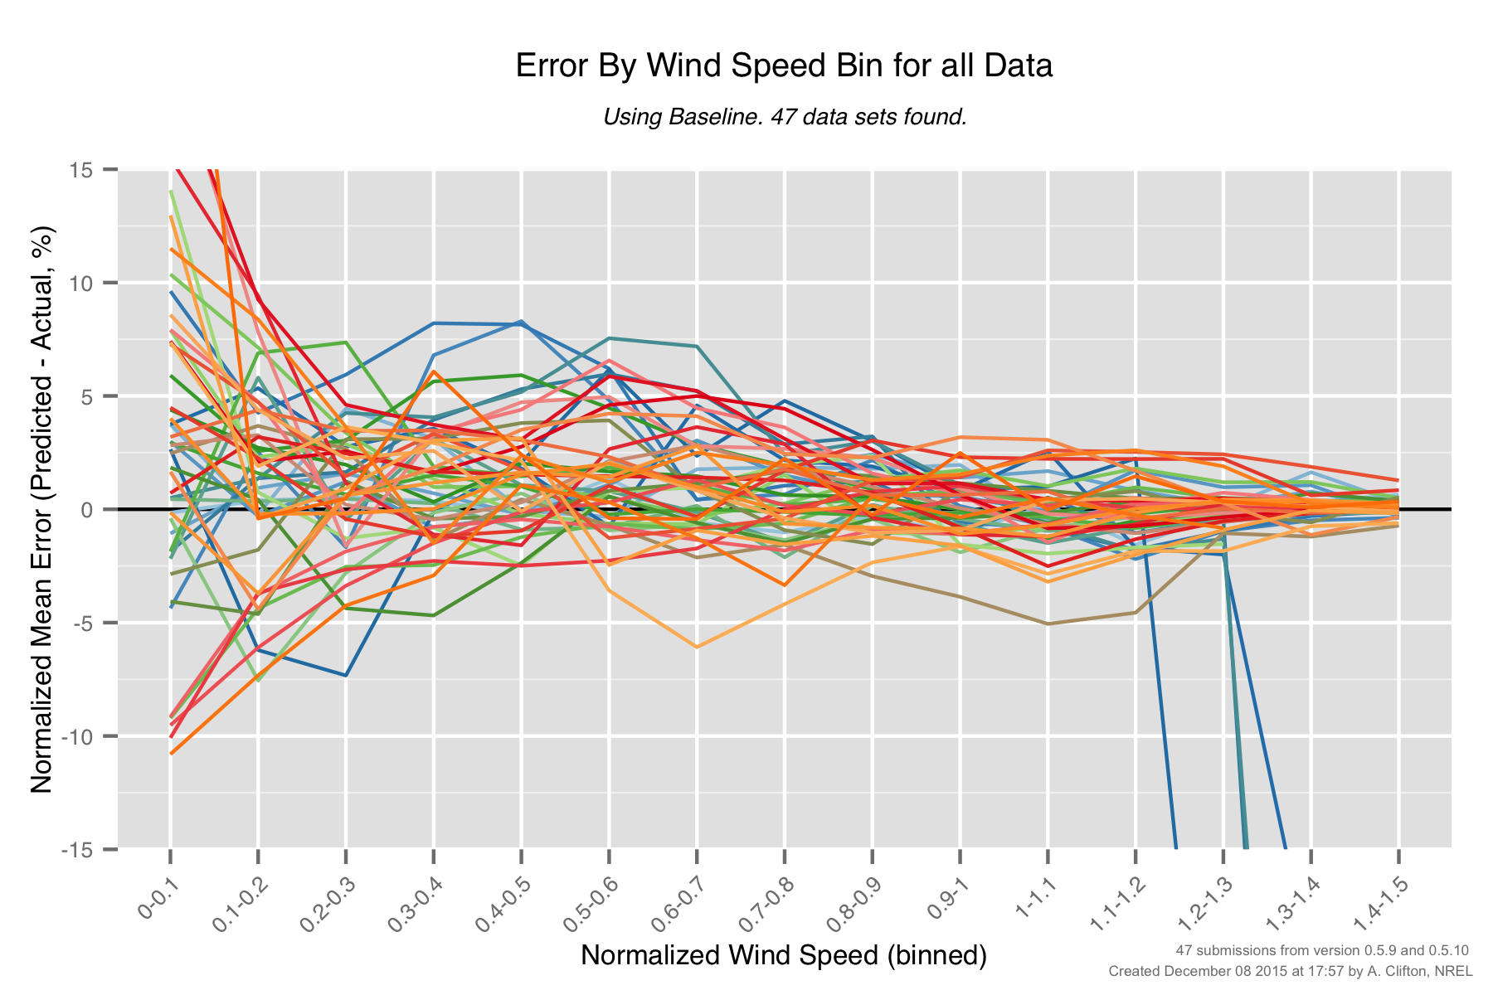
PCWG-Share-01: Baseline Errors by Wind Speed (0.5.9/10)

Slide 26
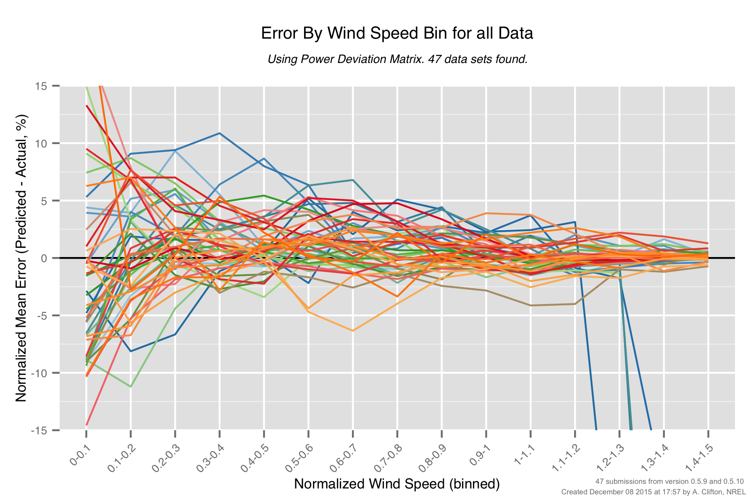
PCWG-Share-01: PDM Errors by Wind Speed (0.5.9/10)

Slide 27
PCWG-Share-01: Baseline Errors by Wind Speed (0.5.9/10)

Slide 28
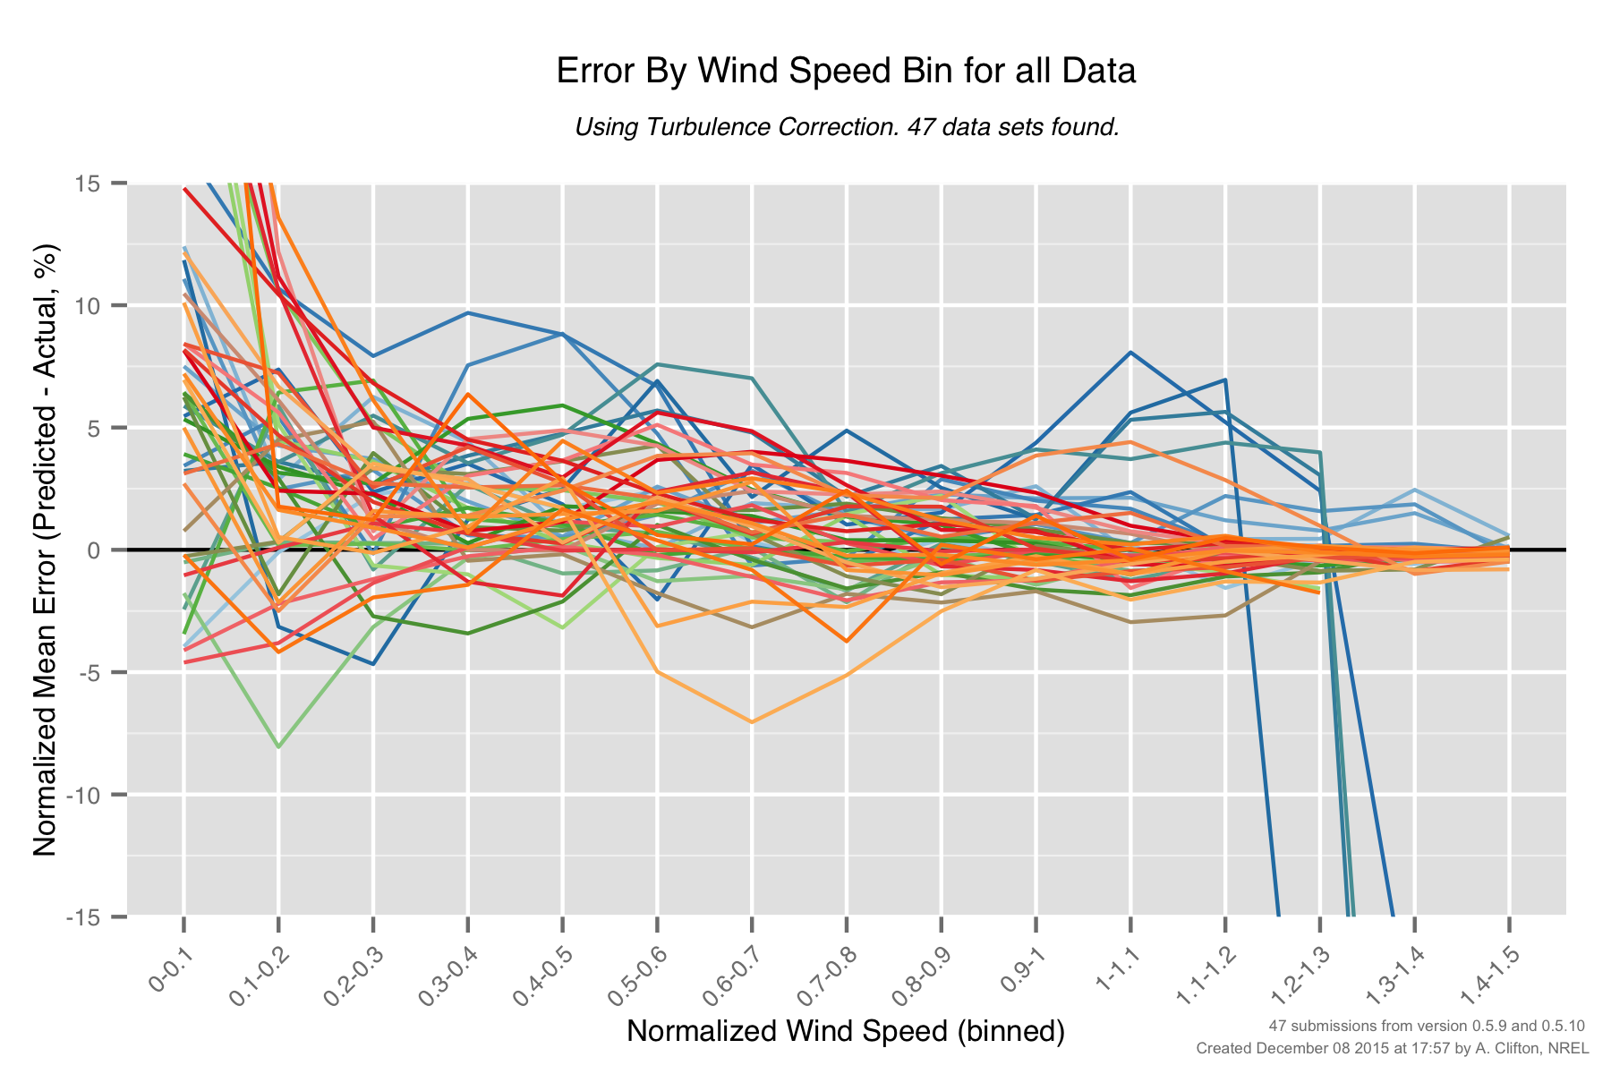
PCWG-Share-01: PDM Errors by Wind Speed (0.5.9/10)

Slide 29
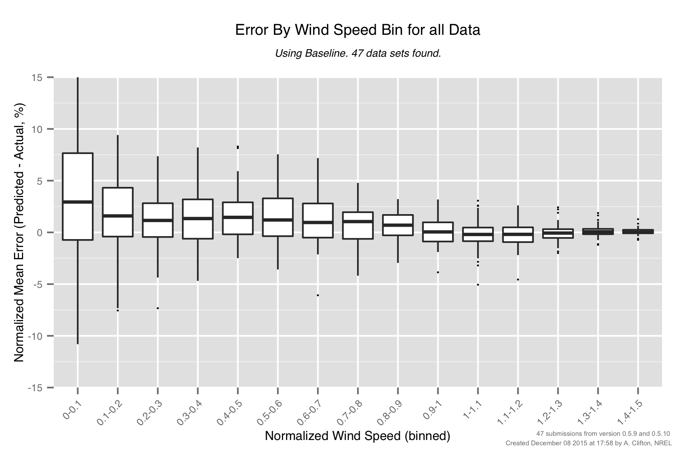
PCWG-Share-01: Baseline Errors by Wind Speed (0.5.9/10)

Slide 30
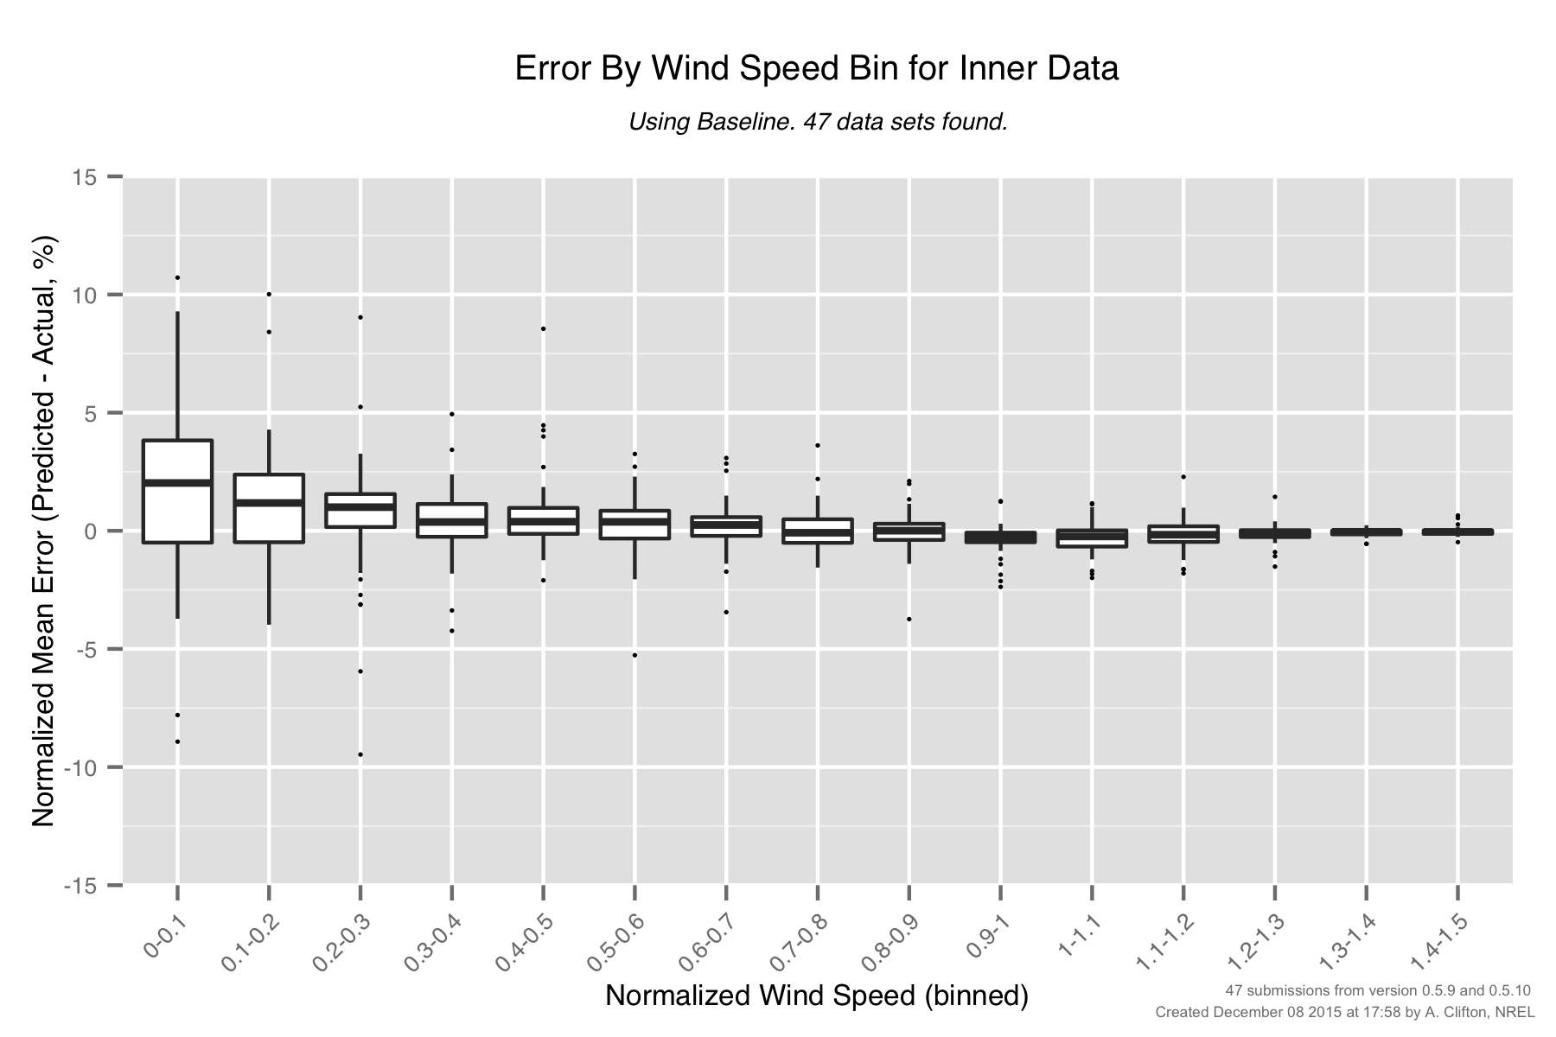
PCWG-Share-01: Inner Baseline Errors by Wind Speed (0.5.9/10)

Slide 31
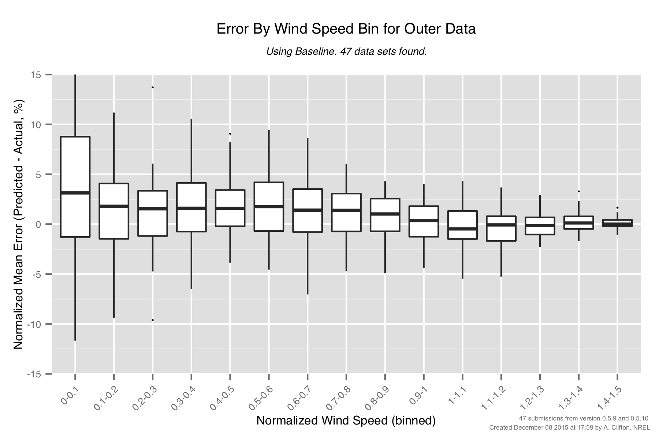
PCWG-Share-01: Outer Baseline Errors by Wind Speed (0.5.9/10)

Slide 32
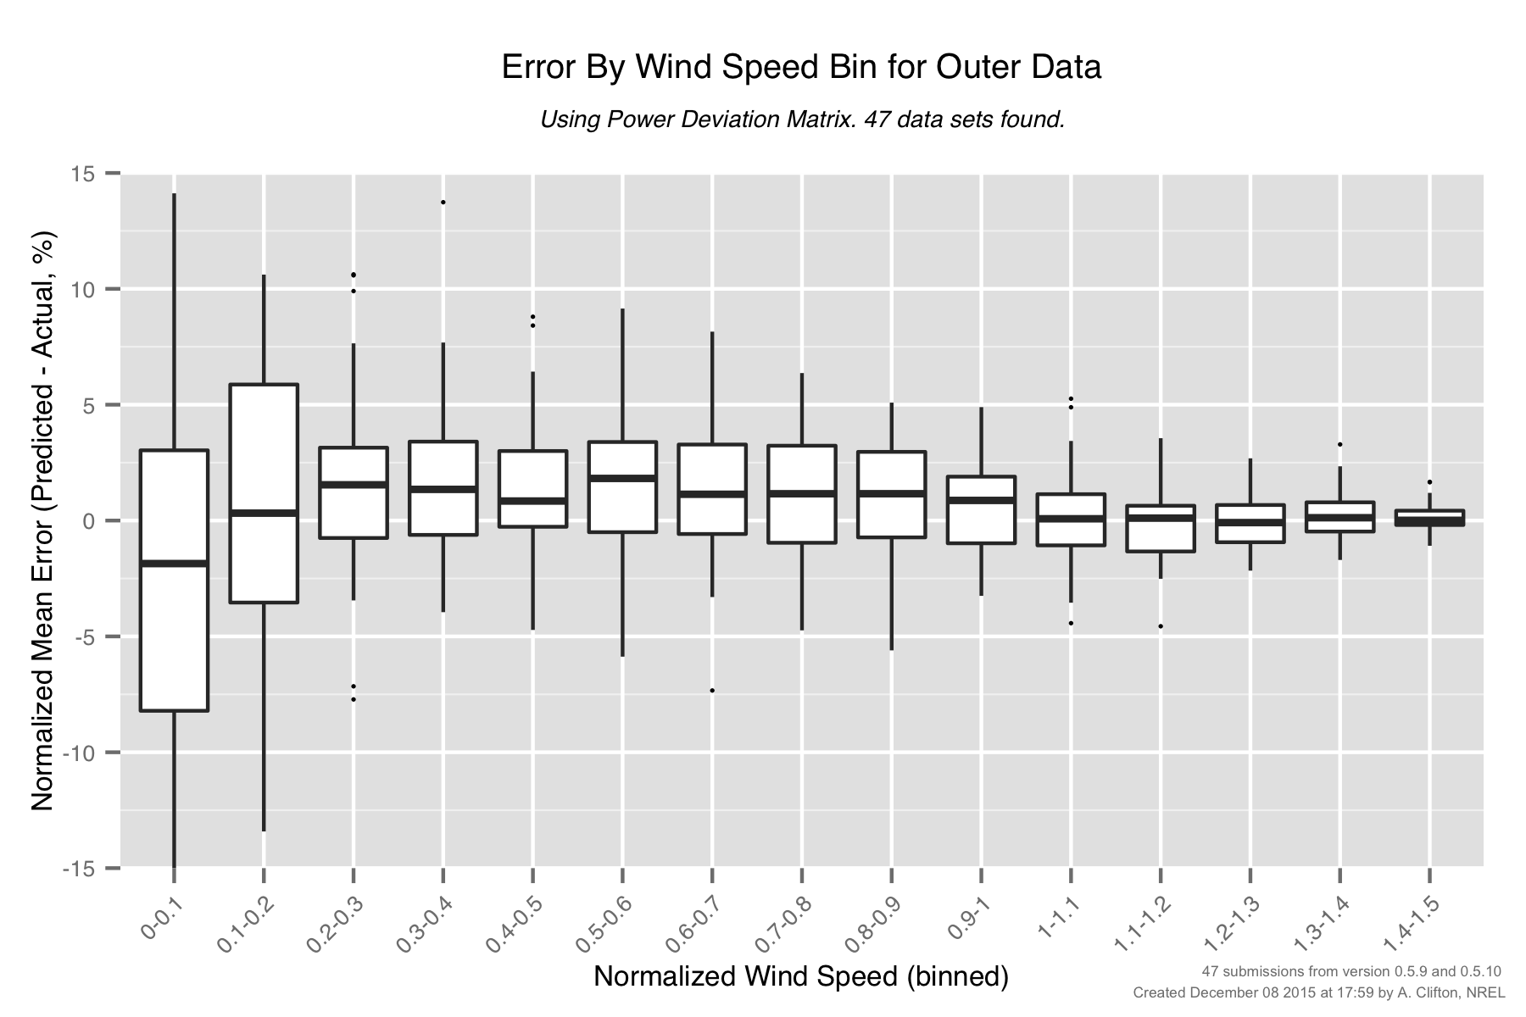
PCWG-Share-01: Outer PDM Errors by Wind Speed (0.5.9/10)

Slide 33
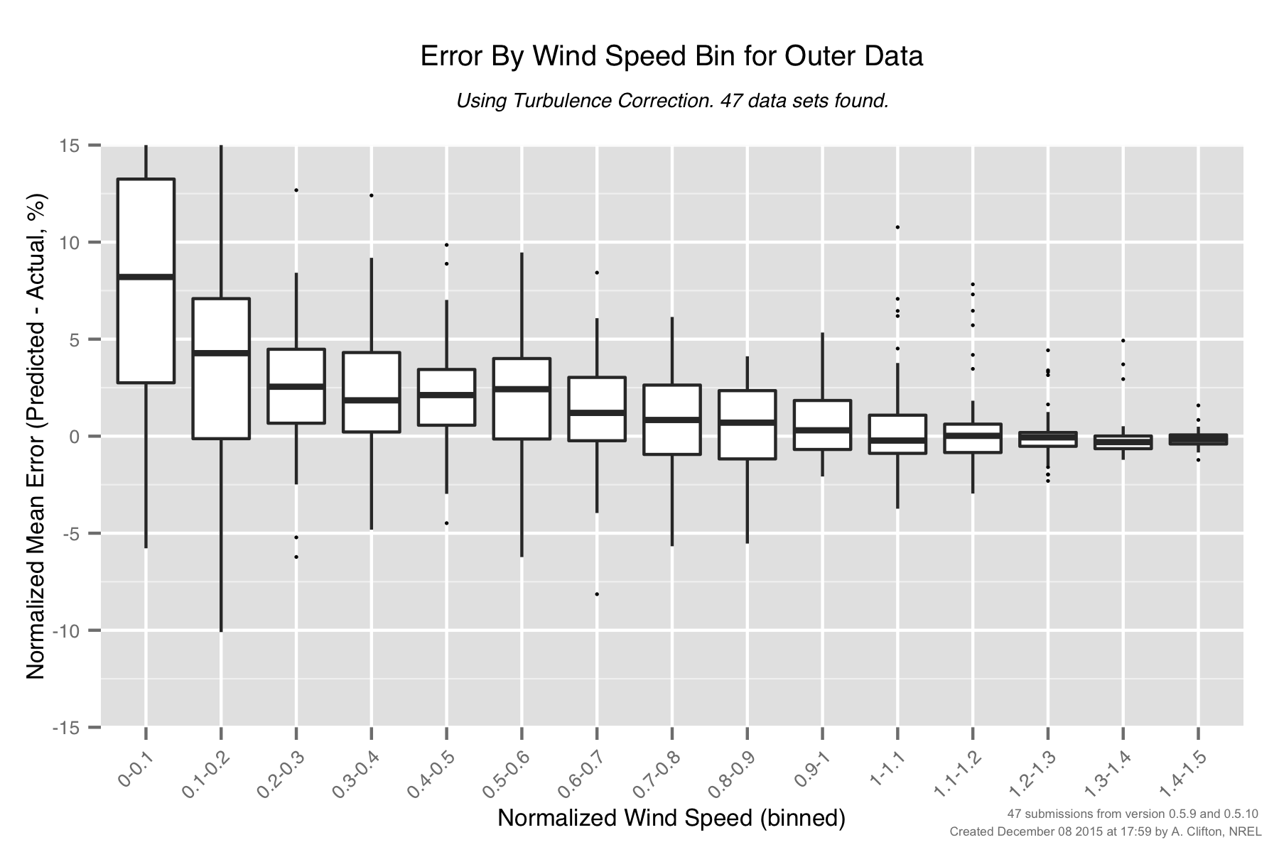
PCWG-Share-01: Outer Turbulence Errors by Wind Speed (0.5.9/10)

Slide 34
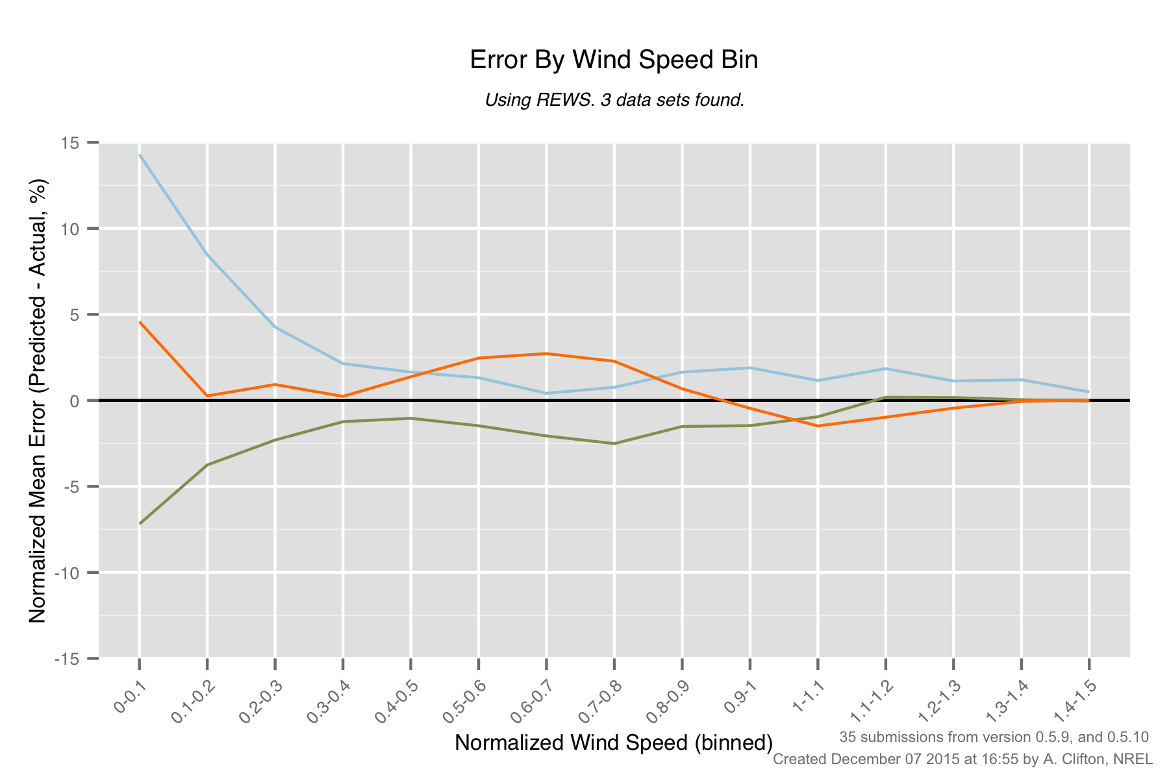
PCWG-Share-01: REWS Errors by Wind Speed (0.5.9/10)

Slide 35
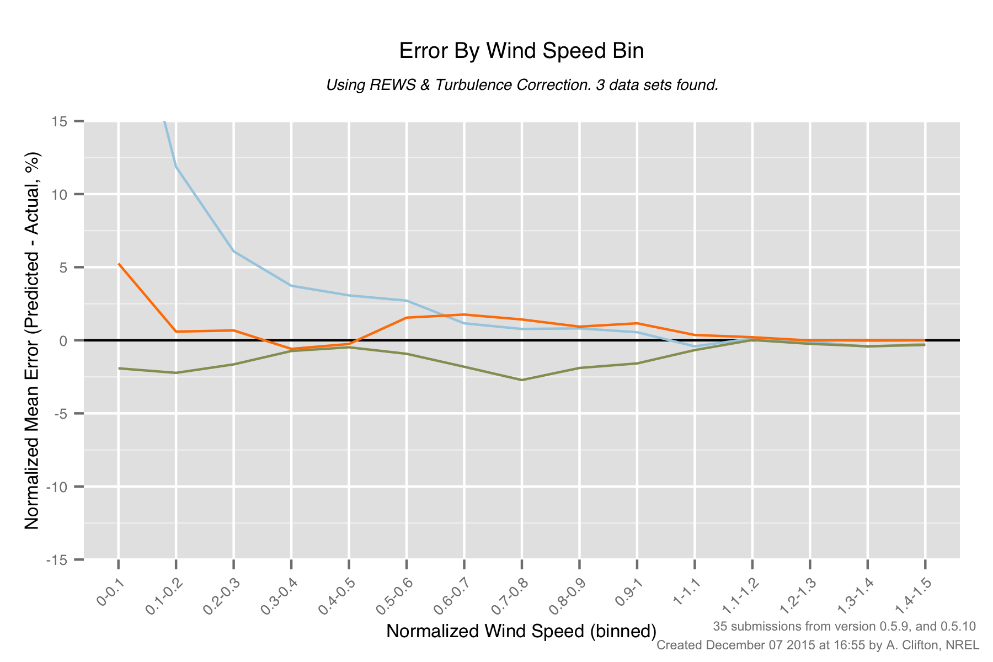
PCWG-Share-01: REWS + Turb Errors by Wind Speed (0.5.9/10)

Slide 36
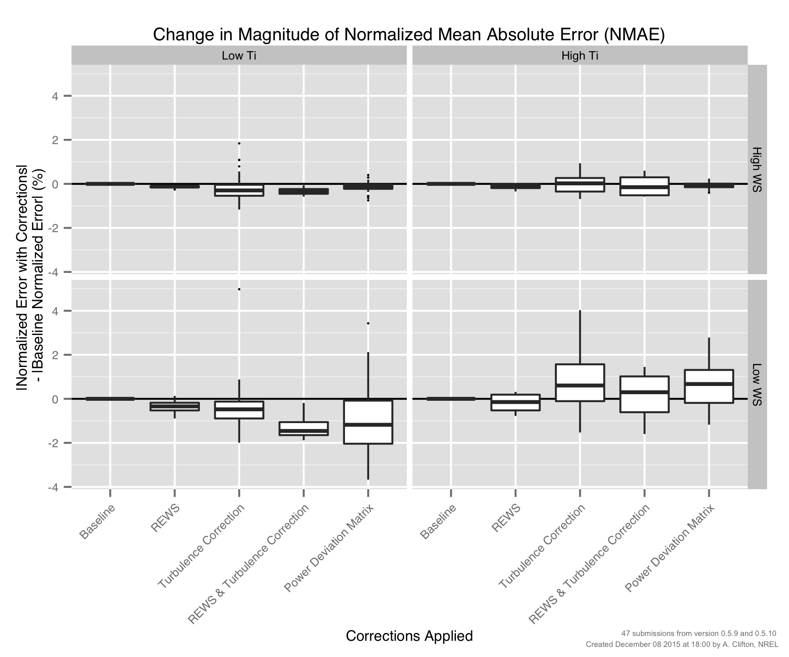
PCWG-Share-01: Errors by Method (‘Four Cell Matrix’)

Slide 37
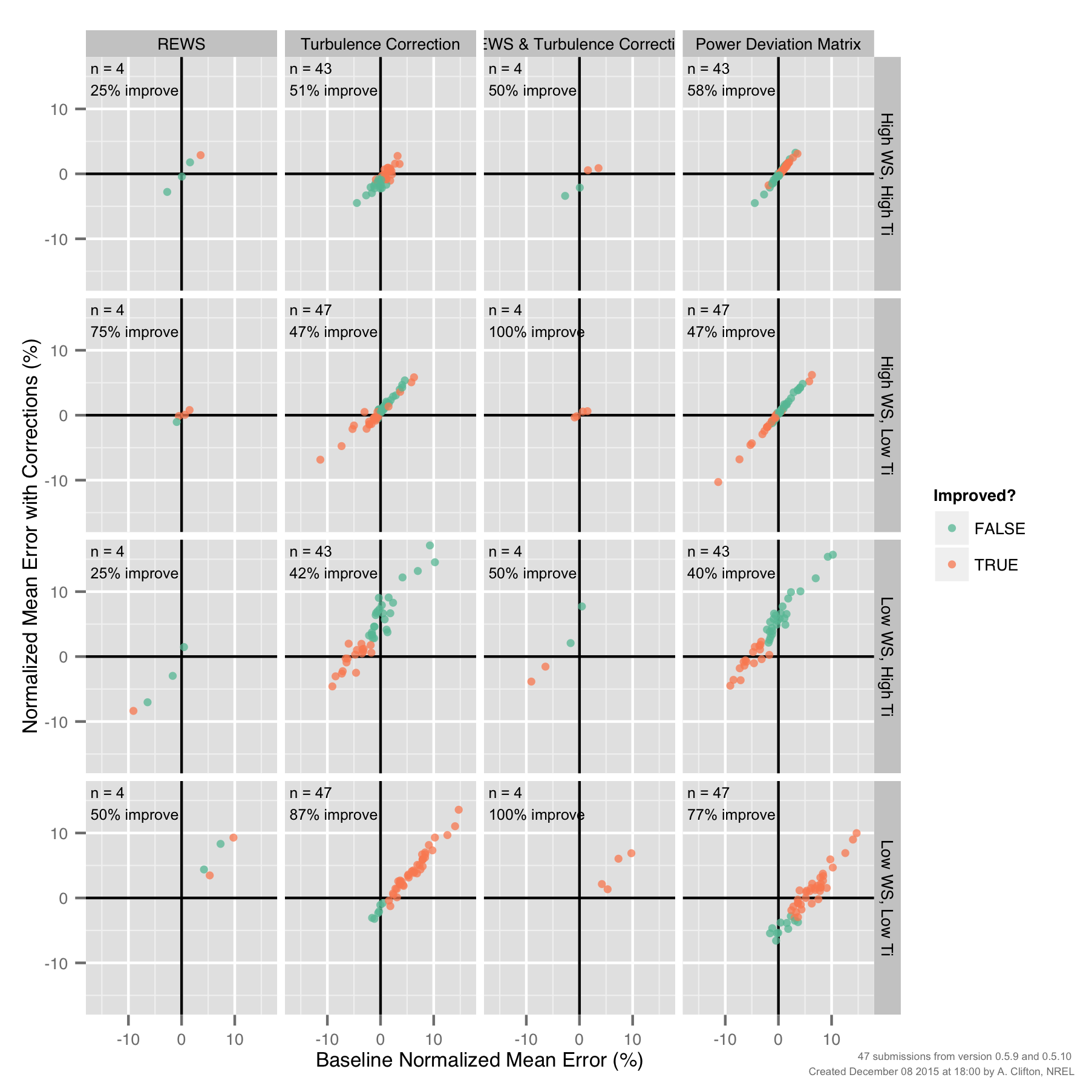
PCWG-Share-01: Improvements by Method (‘Four Cell Matrix’)

Slide 38
Many thanks to all PCWG-Share-01 Participants and special thanks to
Andy Clifton of NREL
Join the Power Curve Working Group at: www.pcwg.org

